Slide 1

Hot Plate Controller Using PID
EN2090 – Laboratory Practice II
Group number 19
180379R : K.A.G.D. Maheekumara
180544U : W.A.V. Ravihansa
180604F : P.H.D.S. Silva
180715V : U.I.D. Wijethunga

Slide 2
Introduction
Power Supply Unit
Sensor interface unit
PID controller Unit
Firing angle controlling system

Slide 3
Power Supply Unit

Slide 4
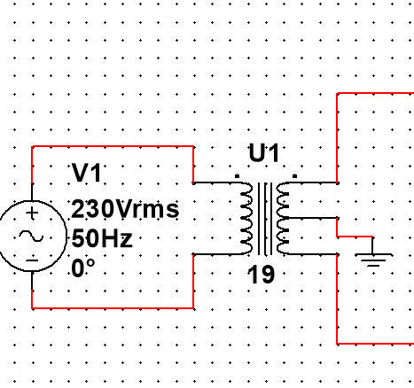
Power supply unit
This unit is mainly use for give all voltages and current according to the main units.
Sensor interfacing unit
PID unit
Firing angle controller unit
This unit mainly have 3 parts,
Step down part
Rectifier part
12V, -12V, 5V output part
Step down part we mainly use center tapped transformer to convert 230V AC to 12V DC current. Because we cannot use direct house voltage for these circuits.

Slide 5
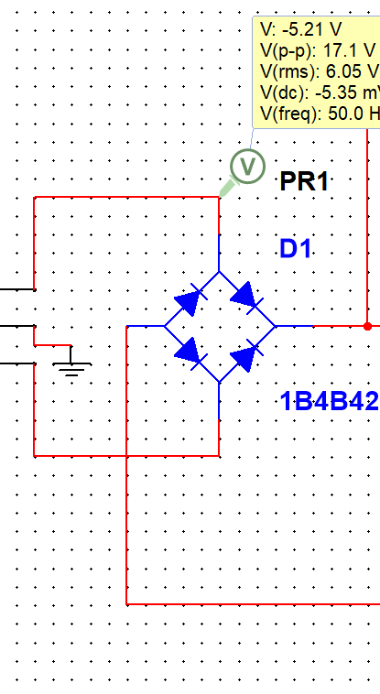
Further we can't use AC current for this circuit so we should convert it to DC current. We can use the second part(Rectifier part) to achieve this purpose. It convert AC voltage to DC voltage.
Then we can get three output by using,
LM7812CT – for 12V DC output
LM7912CT – for –12V DC output
LM7805CT – for 5V DC output

Slide 6
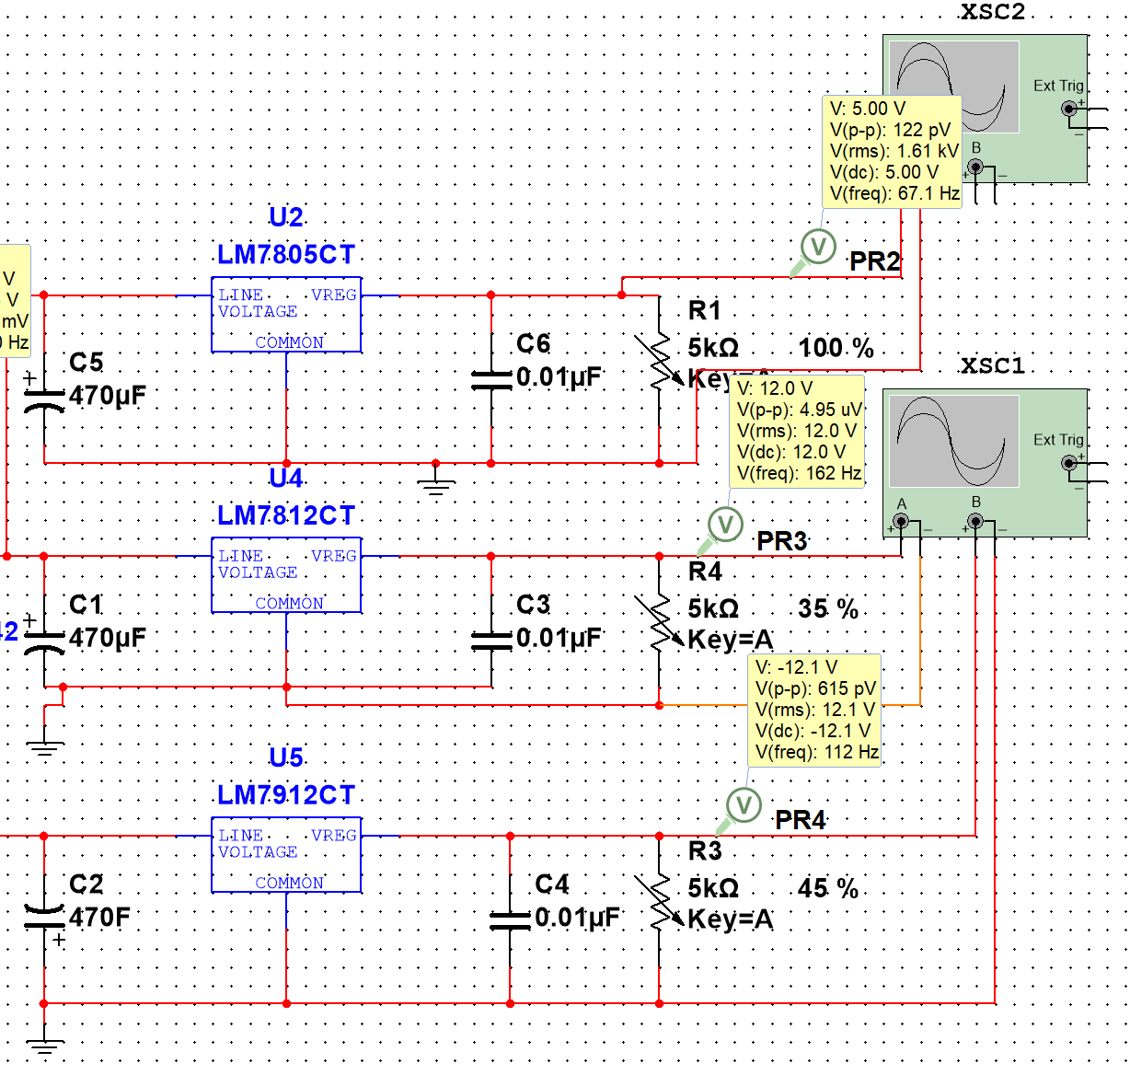
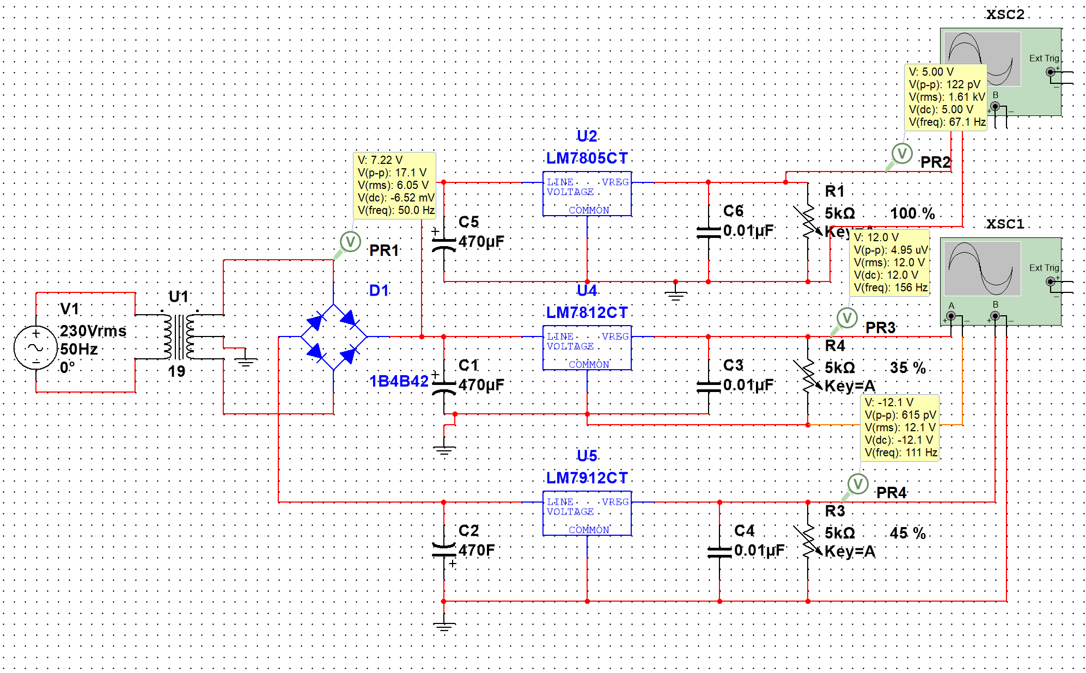
Power supply full circuit

Slide 7
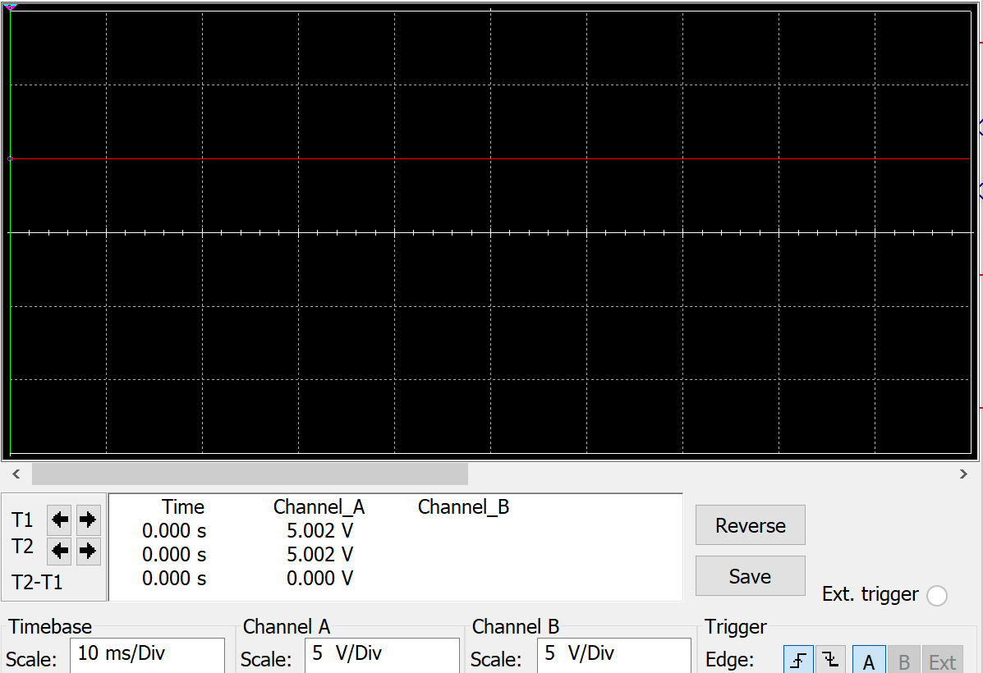
Full circuit simulation result
LM7805CT

Slide 8
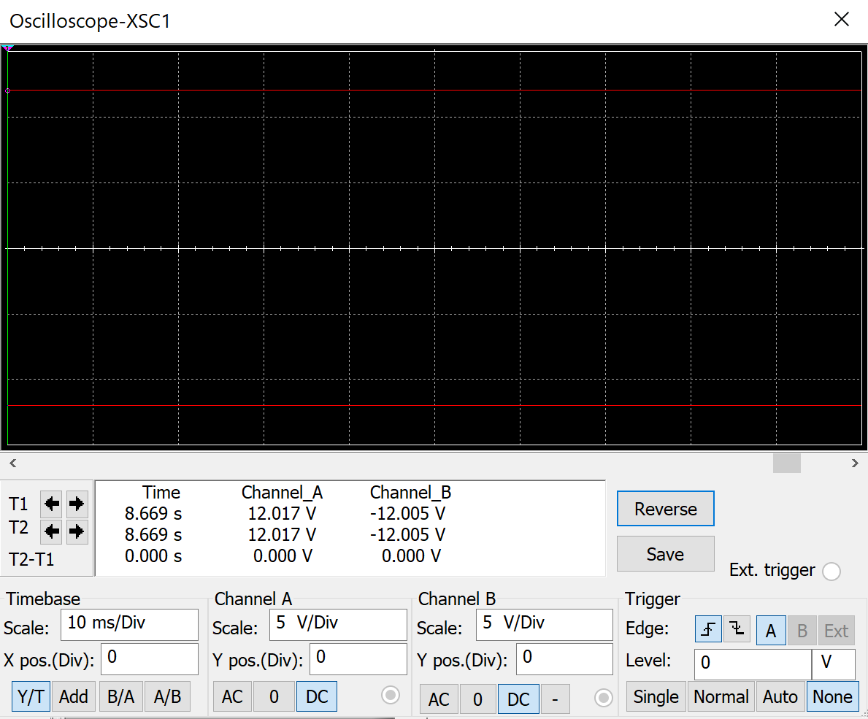
LM7812CT and LM7912CT

Slide 9
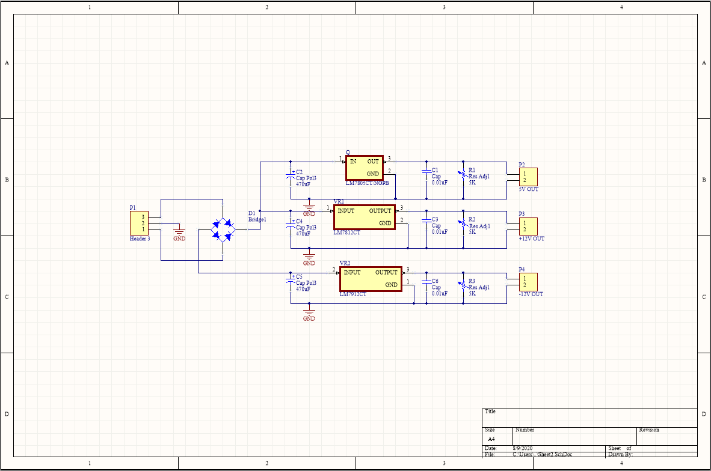
Schematic of Power supply circuit

Slide 10
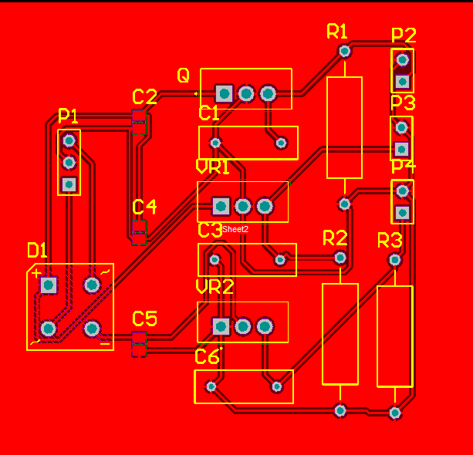
PCB layout of the power supply circuit

Slide 11
SENSOR INTERFACE UNIT

Slide 12
The resistance variation of the selected sensor RTD Pt100 with temperature is approximately linear,
RTD (T ) ≈ RTD0 ( 1 + T × α ) Where:
RTD(T) = the RTD element’s resistance at T (Ω) RTD0 = the RTD element’s resistance at 0°C (Ω) (100 Ω for Pt100) T = the RTD element’s temperature (°C) α = 0.00385 Ω/Ω/°C (Temperature coefficient of RTD element)
As per actual readings obtained for temperature range 0-200°C the resistance varies in the range 100 –175.86 Ω. (https://www.tnpinstruments.com/sitebuildercontent/sitebuilderfiles/pt100_385c_table.pdf)

Slide 13
Analog circuit to take the required temperature, read the sensor reading and to output the difference in temperature as a voltage level. Comprises with,
1mA constant current source.
The RTD requires a 1mA or less constant current for proper operation.
Error generation and amplification unit.
Generation of error (difference between sensor reading and desired temperature as a voltage - input for PID unit).

Slide 14
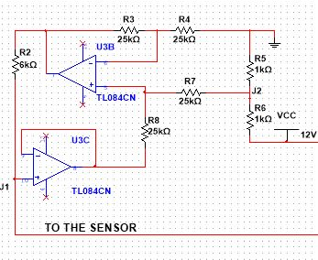
Constant current source
U3B and R3, R4, R7, R8 resistors serve as a differential amplifier with gain=1,
V_{OUT_U3B}= 1*( V_{J2} – (- V_{OUT_U3C} ))
V_{J2} = VCC/2 =6V
Since U3C is a unity gain amplifier V_{OUT_U3C} = V_{J1} .
V_{R2} = V_{OUT_U3B} - V_{J1}
= V_{OUT_U3B} - V_{OUT_U3C}
= V_{J2} = 6V
Therefore current supplied to the sensor= V_{R2} / R₂
= 1mA.
( No backflow at J1 since op amp input resistance is high)

Slide 15
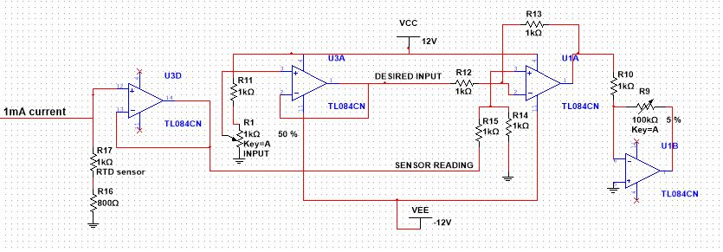
Error Generation
U3D is a unity gain op amp ( to isolate circuit currents),
V_{OUT_U3D} = sensor reading = (RTD resistance + R16) * 1mA
For simulation purposes a potentiometer is used to input the desired input. U3A is a unity gain op amp ,
V_{OUT_U3A} = desired input
U1A is a differential amplifier with gain=1 since all resistance values from R12 to R15 are equal.
V_{OUT_U1A} = 1 x (sensor reading - desired input)
= Error input for PID unit
U1B is an inverting amplifier with variable gain( set by R9 potentiometer and R10 ),
variable gain = R9/R10

Slide 16
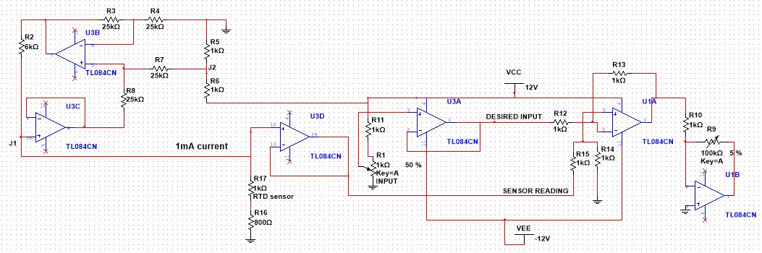

Slide 17
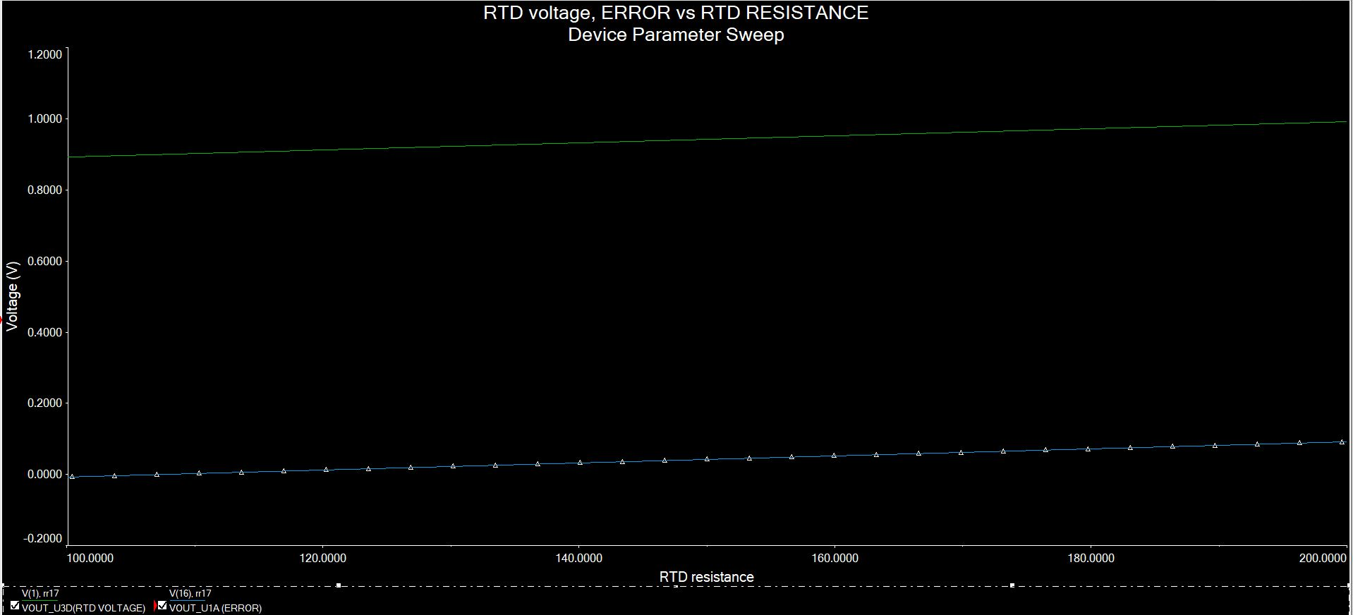
ERROR and VOLTAGE ACROSS RTD VS. RTD RESISTANCE (AT 0.9V DESIRED INPUT)

Slide 18
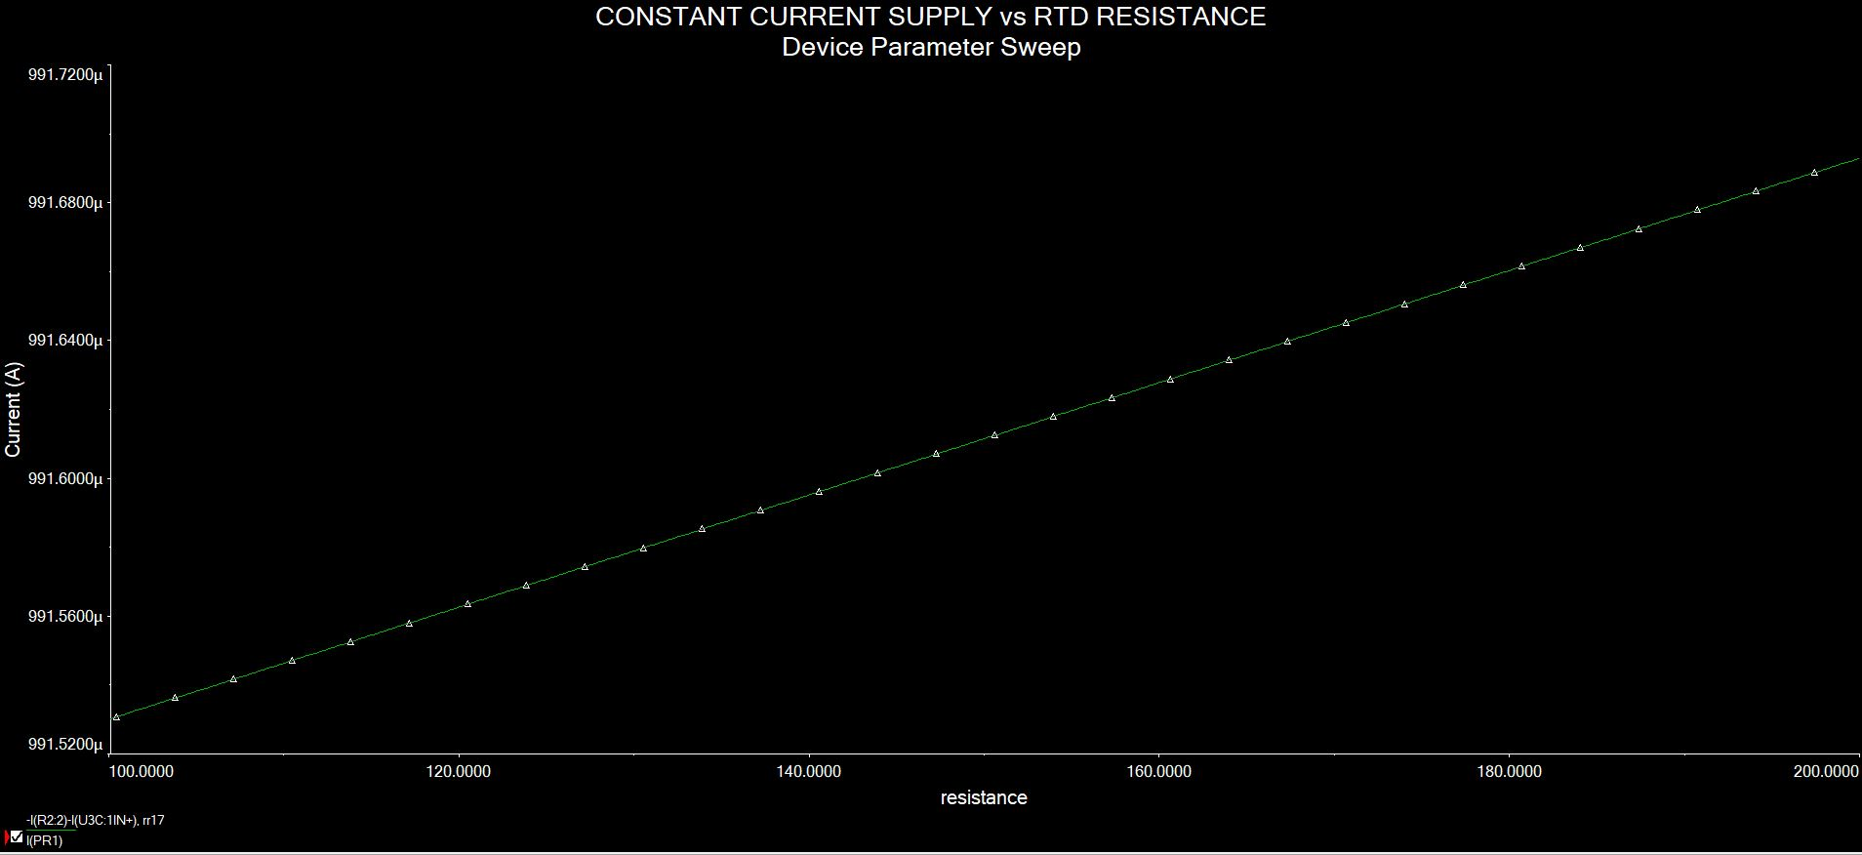
CONSTANT CURRENT SUPPLY vs RTD RESISTANCE

Slide 19
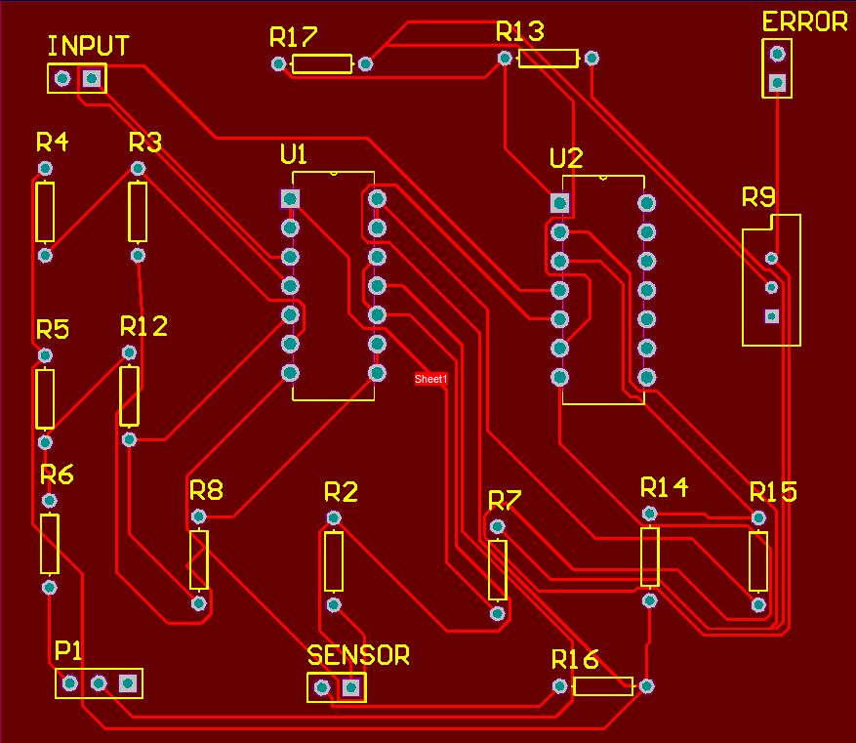
PCB Layout

Slide 20
PID Controller Unit

Slide 21
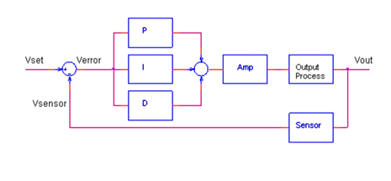
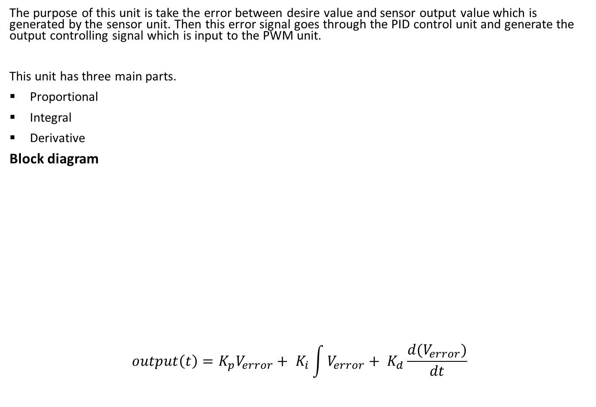
PID CONTROLLER UNIT
The purpose of this unit is take the error between desire value and sensor output value which is generated by the sensor unit. Then this error signal goes through the PID control unit and generate the output controlling signal which is input to the PWM unit.
This unit has three main parts.
Proportional
Integral
Derivative
Block diagram
$$output\left(t\right)=K_{p}V_{error}+ K_{i}\int{V_{error}}+ K_{d}\frac{d(V_{error})}{dt}$$

Slide 22
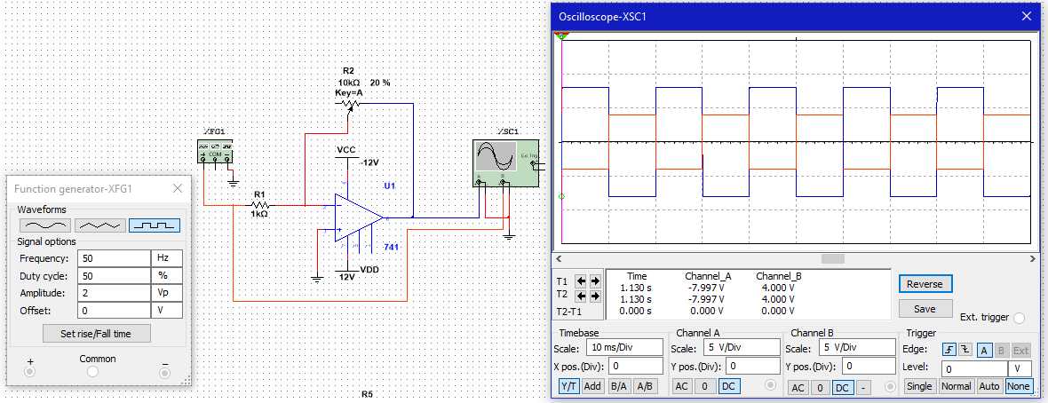

Proportional circuit
We use proportional circuit to produce a one control signal which is proportional to the input error signal. This reduce large part of overall error.
Circuit and simulation result
$$Pout= K_{p}∗V_{error}$$
$K_{p}= R_{P2}/R_{P1}$ (proportional gain constant)
We have to change the Kp value to control the gain of the output.

Slide 23
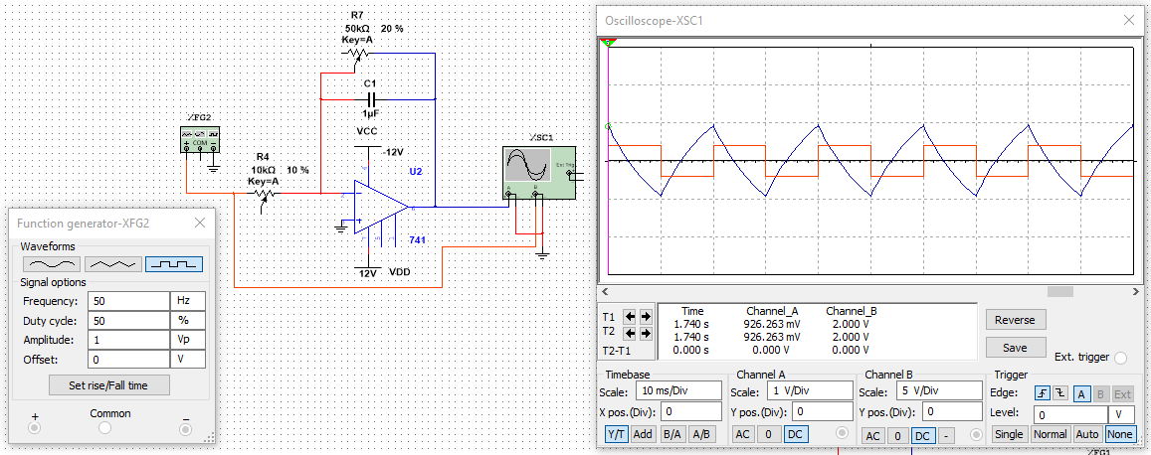

Integral circuit
We use integral circuit to produce sum of the instantaneous error over time.
Circuit and simulation result
$$Iout= K_{I}∗ \int{V_{error}dt}$$
$K_{I}=1/(R_{I}C_{I})$ (integral coefficient)
In the figure we use resistor parallel to the feedback capacitor. The purpose of that resistor is reduce the gain in output.

Slide 24
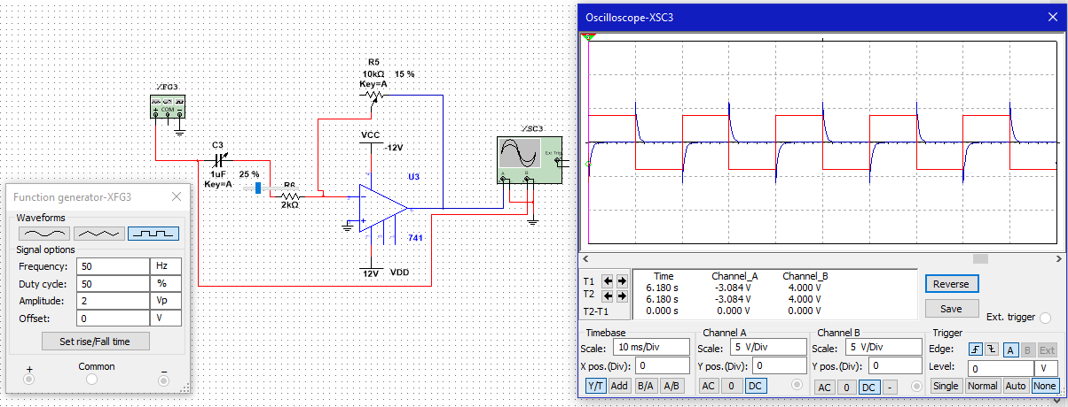
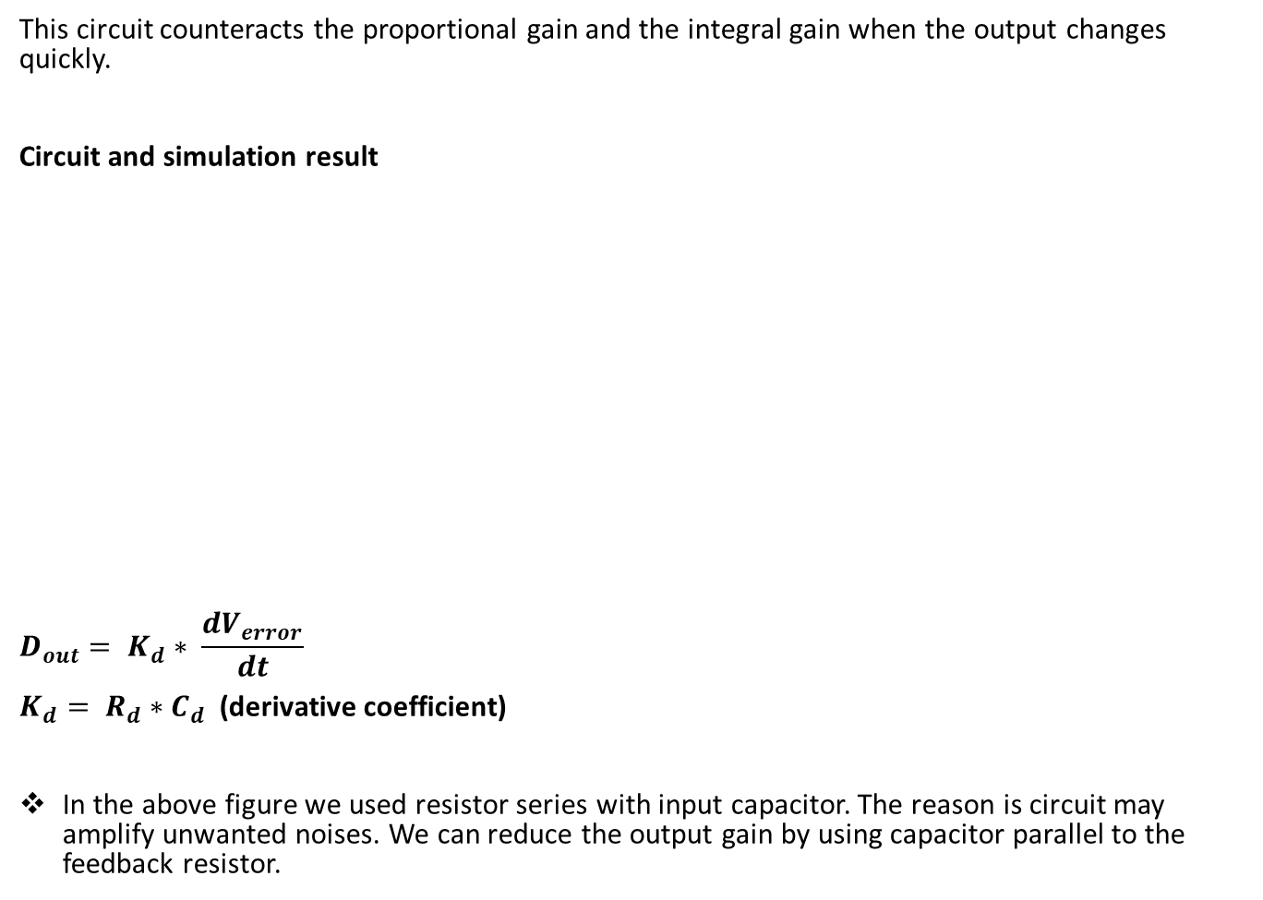
Derivative circuit
This circuit counteracts the proportional gain and the integral gain when the output changes quickly.
Circuit and simulation result
$$D_{out}= K_{d}∗ \frac{dV_{error}}{dt}$$
$K_{d}= R_{d}∗C_{d}$ (derivative coefficient)
In the above figure we used resistor series with input capacitor. The reason is circuit may amplify unwanted noises. We can reduce the output gain by using capacitor parallel to the feedback resistor.

Slide 25
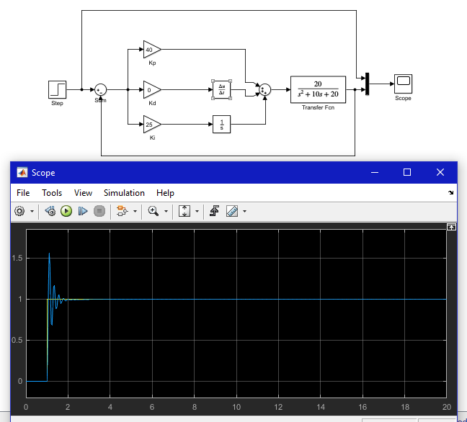
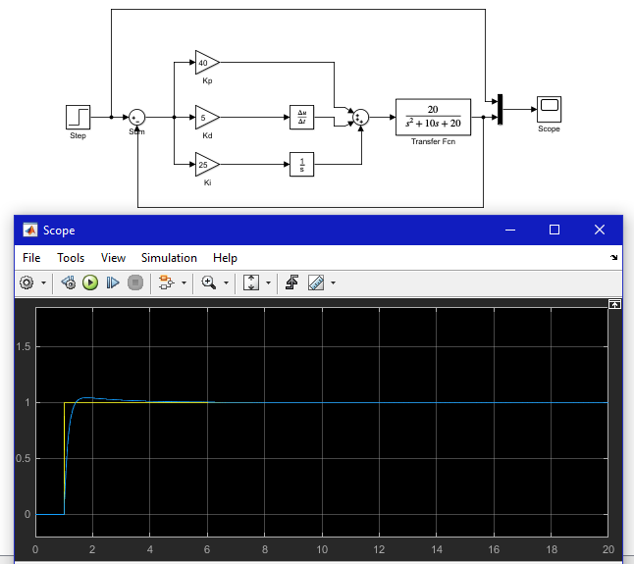
Derivative circuit also helps to reduce the overshoot.
With out Kd
With Kd

Slide 26
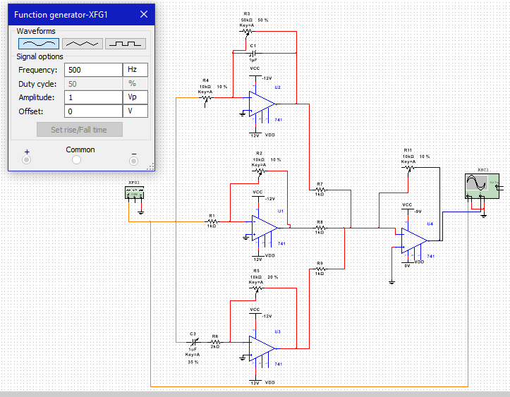
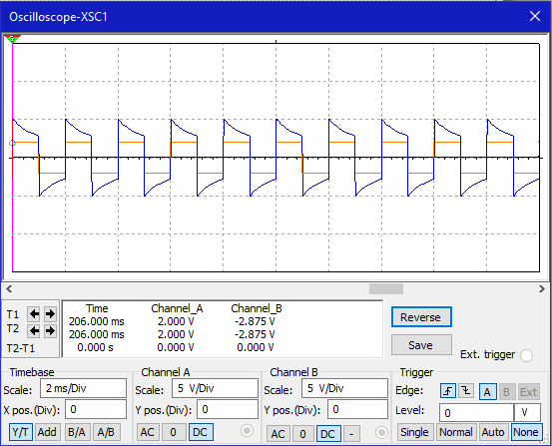
FINAL CIRCUIT SIMULATION RESULT

Slide 27
PID TUNING
Tuning means adjusting three multipliers Kp, Ki, Kd. We have to adjust these values until we get the desire output from the system.
Tuning method
Set Kp. Starting with Kp = 0, Ki = 0 and Kd = 0, increase Kp until the output starts overshooting and ringing significantly.
Set Kd. Increase Kd until the overshoot is reduced to an acceptable level.
Set Ki. Increase Ki until the final error is equal to zero.

Slide 28
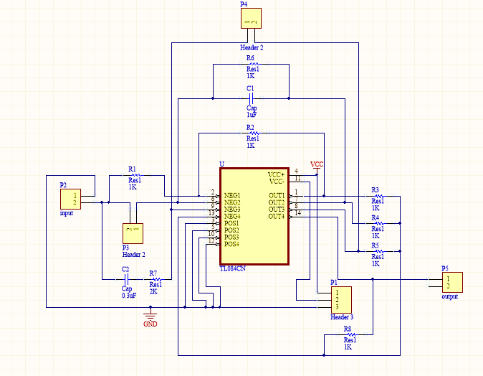
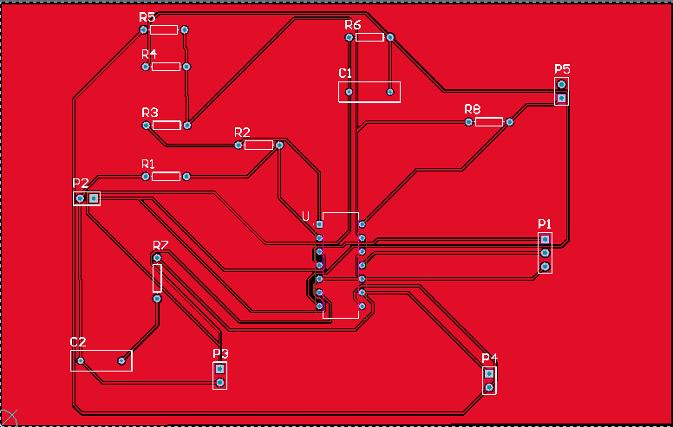
Schematic and PCB layout

Slide 29
Firing Angle Controlling System

Slide 30
Firing Angle Controlling System
Controls the transferring power to hotplate according to the PID output.
Four main parts.
Zero crossing detection
Ramp generation
PWM signal generation
Triggering circuit

Slide 31
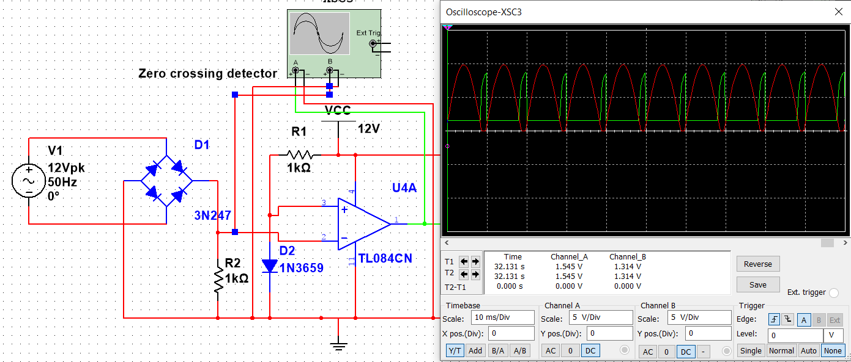
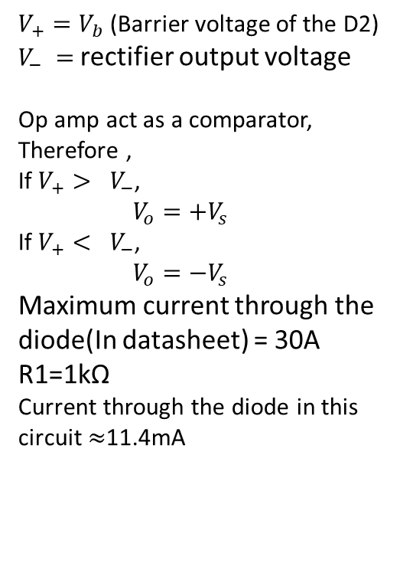
Zero crossing detection
Provides a pulse train in a frequency that is twice as the 230V AC supply.
$V_{+}=V_{b}$ (Barrier voltage of the D2)
$V_{−} =$rectifier output voltage
Op amp act as a comparator,
Therefore ,
If $V_{+}{> V}_{−}$,
$V_{o}=+V_{s}$
If $V_{+}{< V}_{−}$,
$V_{o}=−V_{s}$
Maximum current through the diode(In datasheet) = 30A
R1=1kΩ
Current through the diode in this circuit $≈$11.4mA

Slide 32
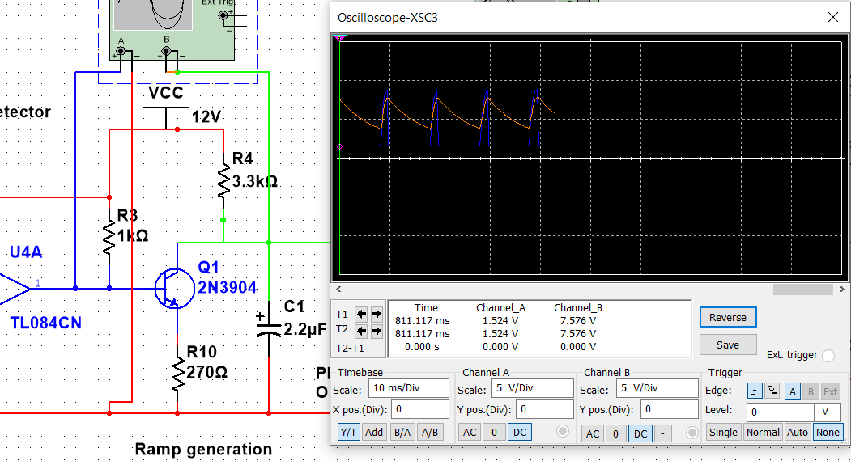

Ramp generation
Creates a ramp using each pulse.
The pulse train is given to the base of the transistor.
When base voltage is low, the transistor act as a open switch.
$$V_{C}=V_{CC}$$
Capacitor is charge up to the collector voltage.
When base voltage is high, the transistor is act as a closed switch. Collector-Emitter voltage will be nearly zero. Capacitor will discharge through the transistor.

Slide 33
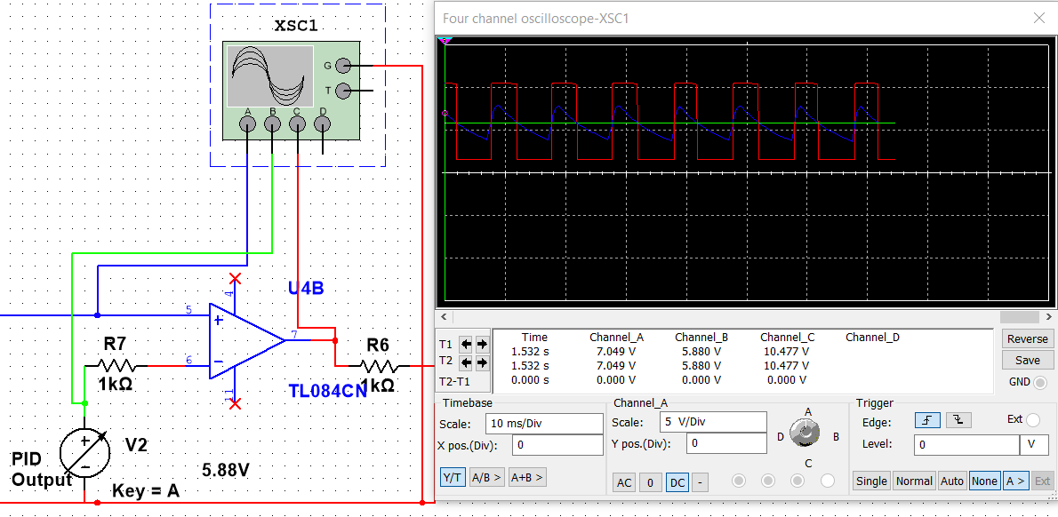
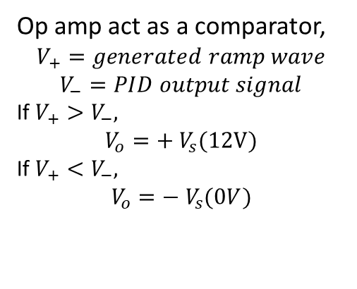
PWM signal generation
Provides a PWM signal which changes its pulse width according to the PID output signal.
Op amp act as a comparator,
$$V_{+}=generated ramp wave$$
$$V_{−}=PID output signal$$
If $V_{+}>V_{−},$
$$V_{o}=+ V_{s}(12V)$$
If $V_{+}<V_{−},$
$$V_{o}=− V_{s}(0V)$$

Slide 34
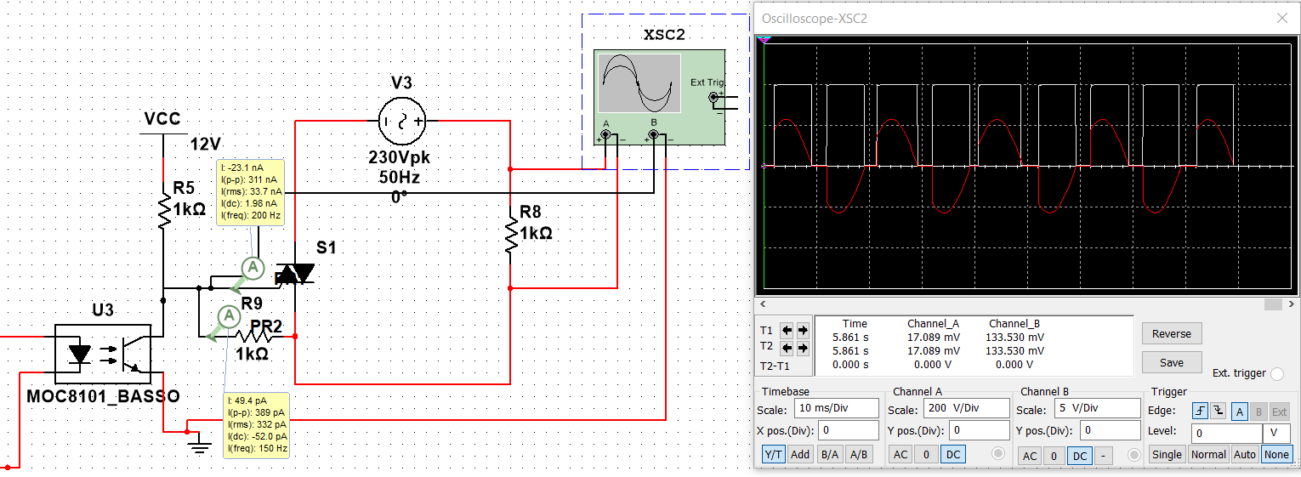
Triggering Circuit
This circuit is isolated using an opto-transistor to protect the low power, control circuit from the 230V circuit.
Once the triac is triggered using a high voltage it allows to flow current trough out the circuit until current becomes zero.

Slide 35
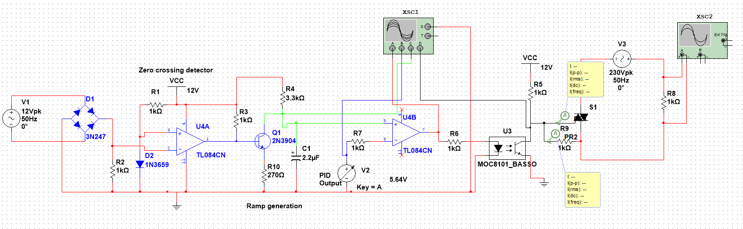
Simulation

Slide 36
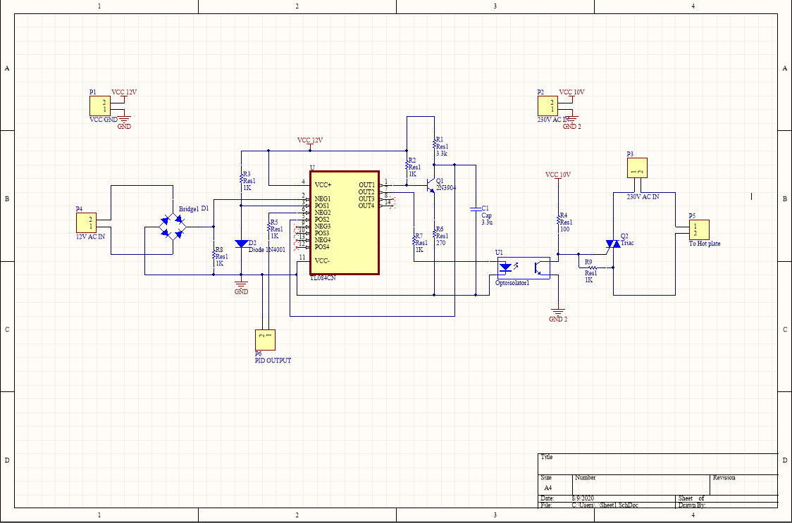
Schematic of Firing angle control circuit

Slide 37
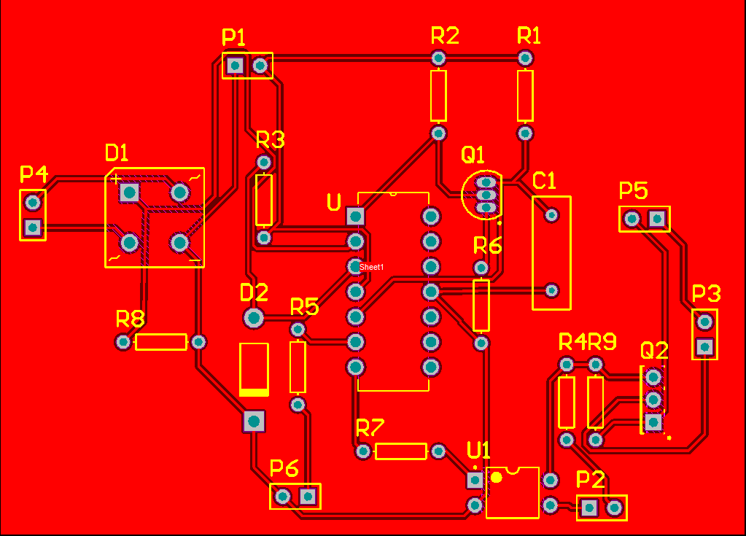
PCB layout of the firing angle control system

Slide 38
Task Delegation
Index | Name | Task
180379R | K.A.G.D. Maheekumara | Power supply unit
180544U | W.A.V. Ravihansa | PID controller unit
180604F | P.H.D.S. Silva | Sensor interface
180715V | U.I.D. Wijethunga | Firing angle control system

Slide 39
Thank you

